Slide 1
OSINT Texnologiyasidan Operativ Maqsadlarda Foydalanish usullari Open Source Intelligence
Techniques
Tools
OSINT
OSINT

Slide 2
ReJA:
OSINT vositalari
Kirish. OSINT tarixi
OSINTdan foydalanish va uning texnikasi
01
02
03
05
04
Razvedkada OSINTning qo’llanishi
OSINTdan foydlanish xavflari

Slide 3
Kirish
Ochiq manbali razvedka (OSINT) - bu razvedka maqsadlari uchun ochiq manbalardan olingan ma'lumotlarni aniqlash, yig'ish, qayta ishlash, tahlil qilish va hisobot berish jarayonidir.
Ochiq manba razvedka tahlilchilari ochiq manbali razvedkaning xilma-xil landshaftini o'rganish va maqsadlariga javob beradigan har qanday ma'lumotlarni aniqlash uchun maxsus usullardan foydalanadilar. OSINT tahlilchilari muntazam ravishda ommaga ochiq bo'lmagan ma'lumotlarni topadilar.
OSINT bepul, sotib olinadigan yoki so'rov bo'yicha olinishi mumkin bo'lgan har qanday oflayn yoki onlayn ma'lumotlarni o'z ichiga oladi.

Slide 4
Quyida ochiq manbali razvedka (OSINT) uchun ishlatiladigan oflayn va onlayn ma'lumotlarning ba'zi misollari keltirilgan.
Oflayn:
Diplomatik: Hukumat, huquqni muhofaza qilish organlari va sudlar, xalqaro agentliklar
Akademik: Akademik tadqiqotlar, jurnallar, dissertatsiyalar
Korporativ: Yillik hisobotlar, konferensiya materiallari, press-relizlar, xodimlar
profililar, rezyumelar
Ommaviy axborot vositalari: televideniye, radio, gazeta, jurnal
Onlayn:
Internet qidiruvi ma'lumotlar bazasi: Google, Bing, Yahoo, Whois
Ijtimoiy tarmoq platformalari: Facebook, Twitter, LinkedIn, Instagram
Ulashish va nashr qilish: Youtube, Flickr, Pinterest, Dailymotion
Bloglar, forumlar va onlayn chatlar: WordPress, Medium, Reddit, 4Chan
Deep Web: Deep Web har qanday indekslanmagan web-sahifalardan iborat (internet qidiruv tizimlari tomonidan mavjud bo'lmagan saytlar).
Dark Web: Darknet kichik tengdoshlar yoki do'stlar orasidagi tarmoqlar, shuningdek Tor va I2P kabi yirik tarmoqlar bo'lishi mumkin. Dark webdagi ko'plab saytlar noqonuniy tarkibga ega.

Slide 5
OSINTdan foydalanish va uning texnikasi
Axborot xavfsizligi guruhlari OSINT dan ikkita asosiy sababga ko'ra foydalanadilar:
1.Jamoatga qaragan ichki aktivlarni aniqlash
OSINT tahlilchilari tashkilotning ommaga ochiq aktivlarini aniqlash uchun kirish testidan foydalanadilar. Axloqiy xakerlik sifatida ham tanilgan penetratsion test kompyuter tizimi, tarmoq yoki veb-ilovaning kiberxavfsizligini sinovdan o'tkazishni o'z ichiga oladi. Xavfsizlik guruhlari penetratsion test orqali aniqlashi mumkin bo'lgan tegishli razvedka ma'lumotlariga quyidagilar kiradi:
Ma'lumotlarning sizib chiqishi, masalan, yaqinda Microsoft PowerApps ma'lumotlarining sizib chiqishi shaxsiy identifikatsiya qilinadigan ma'lumotlarga jamoatchilik kirishiga ruxsat berish uchun tuzilgan portallar orqali sodir bo'ldi.
Zaifliklar mavjud dasturiy ta'minot tuzatilmagani
Ochiq portlar va himoyalanmagan qurilmalar
IP manzillar, tarmoqlar, qurilma nomlari va dasturiy taʼminot versiyalari kabi ochiq aktivlar.

Slide 6
2.Tashqi ma'lumotni aniqlash
Tashkilotlar o'zlarining hujumlarini baholashda tashqi kiber tahdidlarni ham hisobga olishlari kerak. Tashqi tahdidlarni baholash tashkilotning uchinchi tomon risklarni boshqarish dasturi uchun muhimdir, chunki uchinchi tomonlar umumiy hujum vektorlari sifatida ko'tariladi. Ijtimoiy tarmoqlar, jumladan, professional ijtimoiy tarmoqlardagi kontent o'z-o'zidan yaxshi ko'rinishi mumkin. Shunga qaramay, tahdid subyektlari mavjud zaifliklar bilan birgalikda xodimlar va yetkazib beruvchilar tomonidan oshkor qilingan ma'lumotlardan foydalanish orqali kiberhujumlarni boshlashi mumkin. Hatto oddiy internet qidiruvi ham tashkilotning zaif tomonlarini aniqlashi mumkin bo'lsa-da, xavfsizlik guruhlari tashqi tahdidlarni aniqlash uchun Internetning chuqurroq qatlamlarini ham ko'rib chiqadi. Misol uchun, ochiq manbali razvedka tahlilchilari ma'lumotlar sizib chiqishi kabi qo'shimcha ma'lumotlarni to'plash uchun deep va dark webga kirishadi.
Shu sabablarga ko'ra, OSINT Operatsiyalar xavfsizligini (OPSEC) optimallashtirishda juda muhimdir. OPSEC - bu muhim ma'lumotlar yoki maxfiy ma'lumotlarni ochish uchun to'g'ri tahlil qilingan va boshqa ma'lumotlar bilan guruhlangan bo'lsa, potentsial tajovuzkor uchun foydali bo'lishi mumkin bo'lgan do'stona harakatlarni aniqlash jarayoni.

Slide 7
OSINT texnikasi
OSINT razvedka texnikasi ikkita asosiy toifaga bo'linadi: passiv va aktiv.
Passiv qayta tekshirish tizim bilan bevosita bog'lanmasdan maqsadli tarmoq yoki qurilma haqida ma'lumot to'plashni o'z ichiga oladi. OSINT tahlilchilari Windows, Mac, Unix va Linux tizimlari uchun real vaqtda tarmoq trafigini tahlil qiluvchi Wireshark kabi passiv qidiruv vositalaridan foydalangan holda uchinchi tomon ma'lumotlariga tayanadilar. Ular nuqtalarni topish va xaritalash uchun turli xil OSINT ma'lumotlar nuqtalarini birlashtiradi.
Faol esa to'g'ridan-to'g'ri maqsadli tizim bilan bog'lanib, aniqroq va o'z vaqtida ma'lumotlarni taqdim etadi. OSINT tahlilchilari Nmap kabi faol rekonstruksiya vositalaridan foydalanadilar, bu tarmoq xavfsizligining batafsil ko'rinishini ta'minlaydigan tarmoqni aniqlash vositasidir.
Maqsadlarni faol skanerlashni sezish ehtimoli ko'proq, chunki tajovuzni aniqlash tizimlari (IDS) yoki hujumni oldini olish tizimlari (IPS) ochiq portlarga kirishga urinishlarni aniqlay oladi va zaifliklarni skanerlaydi. Axborot xavfsizligi bo'yicha guruhlar o'zlarining tashkiliy ehtiyojlariga xos noyob OSINT texnikasini qo'llashlari kerak bo'lsa-da, umumiy jarayonga rioya qilish samarali razvedka ma'lumotlarini yig'ish uchun asos yaratishga yordam beradi.

Slide 8
Ochiq web-ilovalar xavfsizligi loyihasi 5 bosqichli OSINT jarayonini belgilaydi:
01
Muayyan razvedka talabi uchun ma'lumotni qaerdan topishni aniqlash
Manbani aniqlash
02
Aniqlangan manbadan tegishli ma'lumotlarni to'plash
tO’plash
03
Aniqlangan manba ma'lumotlarini qayta ishlang va mazmunli tushunchalarni olish
Ma'lumotlarni qayta ishlash
04
Bir nechta manbalardagi qayta ishlangan ma'lumotlarni birlashtirish
Tahlil
05
Natijalar bo'yicha yakuniy hisobot yaratish
Hisobot

Slide 9
OSINTdan foydalanish va uning texnikasi
Mercury is the closest planet to the Sun
MERCURY
01
Venus is the second planet from the Sun
venus
02
Despite being red, Mars is very cold
mars
03
Jupiter doesn’t have a solid surface
jupiter
04

Slide 10
DATA ANALYSIS FOR BUSINESS INFOGRAPHICS
2,000,000
Jupiter is the biggest planet in the Solar System
mars
Despite being red, Mars is very cold
60%
Jupiter is a gas giant and the biggest planet in the Solar System. It’s the fourth-brightest object in the night sky
venus
Venus is the second planet from the Sun
40%

Slide 11
DATA ANALYSIS FOR BUSINESS INFOGRAPHICS
Earth is the third planet from the Sun
Venus is the second planet from the Sun
Jupiter doesn’t have a solid surface
Saturn was named after a Roman god
strength
weaknesses
opportunities
threats
S
w
o
t

Slide 12
DATA ANALYSIS FOR BUSINESS INFOGRAPHICS
DATA ANALYSIS
70%
50%
30%
jupiter
EARTH
mars
Jupiter is big
Jupiter is a huge gas giant
Earth has life
Earth is the planet with life
Mars is cold
Mars is full of iron oxide dust

Slide 13
DATA ANALYSIS FOR BUSINESS INFOGRAPHICS
01
EARTH
Earth is the third planet from the Sun
02
MARS
Despite being red, Mars is very cold
03
jupiter
Jupiter doesn’t have a solid surface

Slide 14
DATA ANALYSIS FOR BUSINESS INFOGRAPHICS
MERCURY
VENUS
EARTH
jupiter
It’s the closest planet to the Sun
Venus is the second planet from the Sun
Earth is the third planet from the Sun
Jupiter doesn’t have a solid surface

Slide 15

DATA ANALYSIS FOR BUSINESS INFOGRAPHICS
20XX
Earth is the third planet from the Sun
20XX
Saturn was named after a Roman god
conclusions
Despite being red, Mars is actually a cold place
Mars is very cold
Follow the link in the graph to modify its data and then paste the new one here. For more info, click here

Slide 16
DATA ANALYSIS FOR BUSINESS INFOGRAPHICS
Venus is a hot planet
venus
Mercury is a small planet
MERCURY
Jupiter is a gas giant
jupiter
It’s full of iron oxide dust
MARS

Slide 17
DATA ANALYSIS FOR BUSINESS INFOGRAPHICS
mercury
mars
50%
80%
Mercury is a very small planet
Despite being red, Mars is very cold
venus
jupiter
30%
90%
Venus is the second planet from the Sun
Jupiter doesn’t have a solid surface
EARTH
saturn
20%
70%
Earth is the third planet from the Sun
Saturn was named after a Roman god

Slide 18
DATA ANALYSIS FOR BUSINESS INFOGRAPHICS
01
Saturn
Saturn was named after a Roman god
02
Jupiter
Earth
Jupiter was named after a Roman god
Earth is the third planet from the Sun and the only one that harbors life in the Solar System. All humans live on this planet
03
Mars
Mars is full of iron oxide dust

Slide 19
DATA ANALYSIS FOR BUSINESS INFOGRAPHICS
MON | TUE | WED | THU | FRI | SAT | SUN
1 | 2 | 3 | 4 | 5 | 6 | 7
8 | 9 | 10 | 11 | 12 | 13 | 14
15 | 16 | 17 | 18 | 19 | 20 | 21
22 | 23 | 24 | 25 | 26 | 27 | 28
29 | 30 | 31
EARTH
Earth is the third planet from the Sun
jupiter
Jupiter doesn’t have a solid surface

Slide 20
DATA ANALYSIS FOR BUSINESS INFOGRAPHICS
02
04
Mercury is the closest planet to the Sun
venus
Earth is the only planet that harbors life
mars
Venus is the second planet from the Sun
Despite being red, Mars is actually a cold place
MERCURY
earth
01
03

Slide 21
DATA ANALYSIS FOR BUSINESS INFOGRAPHICS
70%
venus
Venus is extremely hot, even hotter than Mercury
90%
mars
Despite being red, Mars is actually a cold place
40%
jupiter
Jupiter is the biggest planet in the Solar System

Slide 22
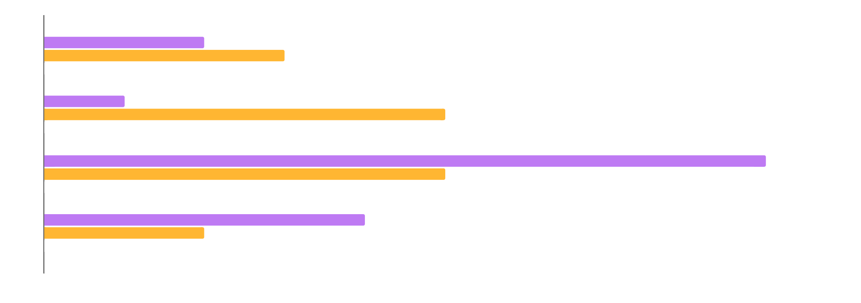
DATA ANALYSIS FOR BUSINESS INFOGRAPHICS
MERCURY
Mercury is a small planet
VENUS
Venus is a hot planet
mars
It is made of basalt
Follow the link in the graph to modify its data and then paste the new one here. For more info, click here

Slide 23
DATA ANALYSIS FOR BUSINESS INFOGRAPHICS
60%
40%
80%
VENUS
EARTH
jupiter
Venus is the second planet from the Sun
Earth is the third planet from the Sun
Jupiter doesn’t have a solid surface

Slide 24
DATA ANALYSIS FOR BUSINESS INFOGRAPHICS
MERCURY
Mercury is a small planet
MARS
It’s full of iron oxide dust
jupiter
Jupiter is a gas giant
venus
Venus is a hot planet

Slide 25
DATA ANALYSIS FOR BUSINESS INFOGRAPHICS
JAN | FEB | MAR | APR | MAY | JUN | JUL | AGO | SEP | OCT | NOV | DIC
MARS
jUPITER
SATURN
mars
jupiter
saturn
Despite being red, Mars is very cold
Jupiter doesn’t have a solid surface
Saturn was named after a Roman god

Slide 26
DATA ANALYSIS FOR BUSINESS INFOGRAPHICS
03
02
earth
Earth is the third planet from the Sun
01
mars
Despite being red, Mars is very cold
jupiter
Jupiter doesn’t have a solid surface

Slide 27
DATA ANALYSIS FOR BUSINESS INFOGRAPHICS
jupiter
saturn
mars
neptune
Jupiter is the biggest planet in the Solar System
Saturn has a high number of moons, like Jupiter
Despite being red, Mars is actually a cold place
Neptune is the farthest planet from the Sun

Slide 28
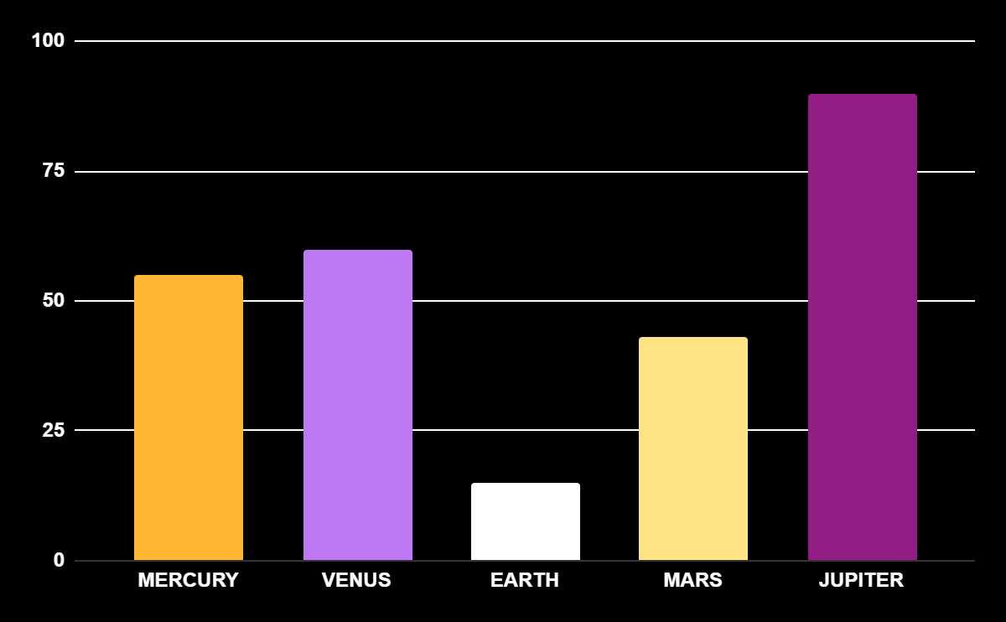
DATA ANALYSIS FOR BUSINESS INFOGRAPHICS
MERCURY
It’s the closest planet to the Sun
VENUS
It’s the second planet from the Sun
EARTH
Earth is the planet with life
MARS
Mars was named after a god
JUPITER
Jupiter doesn’t have a solid surface
Follow the link in the graph to modify its data and then paste the new one here. For more info, click here

Slide 29
DATA ANALYSIS FOR BUSINESS INFOGRAPHICS
01
It’s the closest planet to the Sun
MERCURY
02
Saturn was named after a Roman god
saturn
03
Earth is the only planet with life
EARTH
04
Mars was named after a god
MARS
05
Jupiter doesn’t have a solid surface
JUPITER

Slide 30
DATA ANALYSIS FOR BUSINESS INFOGRAPHICS
mercury
Mercury is the closest planet to the Sun and the smallest of them all
jupiter
Jupiter is a gas giant and the biggest planet in the Solar System
venus
Venus has a beautiful name and is the second planet from the Sun

Slide 31
DATA ANALYSIS FOR BUSINESS INFOGRAPHICS
01
mars
Despite being red, Mars is very cold
Venus is the second planet from the Sun
venus
02
03
earth
Earth is the third planet from the Sun

Slide 32
DATA ANALYSIS FOR BUSINESS INFOGRAPHICS
20XX
mercury
Mercury is the closest planet to the Sun
20XX
venus
Venus is the second planet from the Sun
20XX
earth
Earth is the third planet from the Sun
20XX
mars
Despite being red, Mars is very cold
20XX
jupiter
Jupiter is the biggest planet of them all
20XX
saturn
Saturn was named after a Roman god

Slide 33
DATA ANALYSIS FOR BUSINESS INFOGRAPHICS
Venus is the second planet from the Sun
Venus
jupiter
saturn
Jupiter doesn’t have a solid surface
Saturn was named after a Roman god
mercury
mars
It’s the closest planet to the Sun
Despite being red, Mars is very cold

Slide 34
DATA ANALYSIS FOR BUSINESS INFOGRAPHICS
01
02
EARTH
jupiter
Earth is the third planet from the Sun
Jupiter doesn’t have a solid surface
03
04
MARS
SATURN
Despite being red, Mars is very cold
Saturn was named after a Roman god

Slide 35
DATA ANALYSIS FOR BUSINESS INFOGRAPHICS
 | Business intelligence | Data analytics
Definition | Mercury is the closest planet to the Sun | Venus is the second planet from the Sun
Usage | Earth is the third planet from the Sun | Despite being red, Mars is very cold
Application | Jupiter was named after a Roman god | Saturn is a gas giant with several rings

Slide 36
DATA ANALYSIS FOR BUSINESS INFOGRAPHICS
saturn
jupiter
neptune
Saturn has a high number of moons, like Jupiter
Jupiter is the biggest planet in the Solar System
Neptune is the farthest planet from the Sun
40%
earth
70%
mercury
90%
pluto
60%
mars
30%
venus
10%
ceres

Slide 37
DATA ANALYSIS FOR BUSINESS INFOGRAPHICS
jupiter
saturn
Jupiter doesn’t have a solid surface
Saturn was named after a Roman god
venus
mercury
neptune
It’s the closest planet to the Sun
Neptune is very far away from the Sun

Slide 38
Instructions for use
If you have a free account, in order to use this template, you must credit Slidesgo in your final presentation. Please refer to the next slide to read the instructions for premium users.
As a Free user, you are allowed to:
- Modify this template.
- Use it for both personal and commercial projects.
You are not allowed to:
- Sublicense, sell or rent any of Slidesgo Content (or a modified version of Slidesgo Content).
- Distribute Slidesgo Content unless it has been expressly authorized by Slidesgo.
- Include Slidesgo Content in an online or offline database or file.
- Offer Slidesgo templates (or modified versions of Slidesgo templates) for download.
- Acquire the copyright of Slidesgo Content.
For more information about editing slides, please read our FAQs or visit our blog:
https://slidesgo.com/faqs and https://slidesgo.com/slidesgo-school

Slide 39
Instructions for use (premium users)
As a Premium user, you can use this template without attributing Slidesgo.
You are allowed to:
Modify this template.
Use it for both personal and commercial purposes.
Share this template in an editable format with people who are not part of your team.
You are not allowed to:
Sublicense, sell or rent this Slidesgo Template (or a modified version of this Slidesgo Template).
Distribute this Slidesgo Template (or a modified version of this Slidesgo Template) or include it in a database or in any other product or service that offers downloadable images, icons or presentations that may be subject to distribution or resale.
Use any of the elements that are part of this Slidesgo Template in an isolated and separated way from this Template.
Register any of the elements that are part of this template as a trademark or logo, or register it as a work in an intellectual property registry or similar.
For more information about editing slides, please read our FAQs or visit our blog:
https://slidesgo.com/faqs and https://slidesgo.com/slidesgo-school

Slide 40
Infographics
You can add and edit some infographics to your presentation to present your data in a visual way.
Choose your favourite infographic and insert it in your presentation using Ctrl C + Ctrl V or Cmd C + Cmd V in Mac.
Select one of the parts and ungroup it by right-clicking and choosing “Ungroup”.
Change the color by clicking on the paint bucket.
Then resize the element by clicking and dragging one of the square-shaped points of its bounding box (the cursor should look like a double-headed arrow). Remember to hold Shift while dragging to keep the proportions.
Group the elements again by selecting them, right-clicking and choosing “Group”.
Repeat the steps above with the other parts and when you’re done editing, copy the end result and paste it into your presentation.
Remember to choose the “Keep source formatting” option so that it keeps the design. For more info, please visit our blog.

